Slide 1
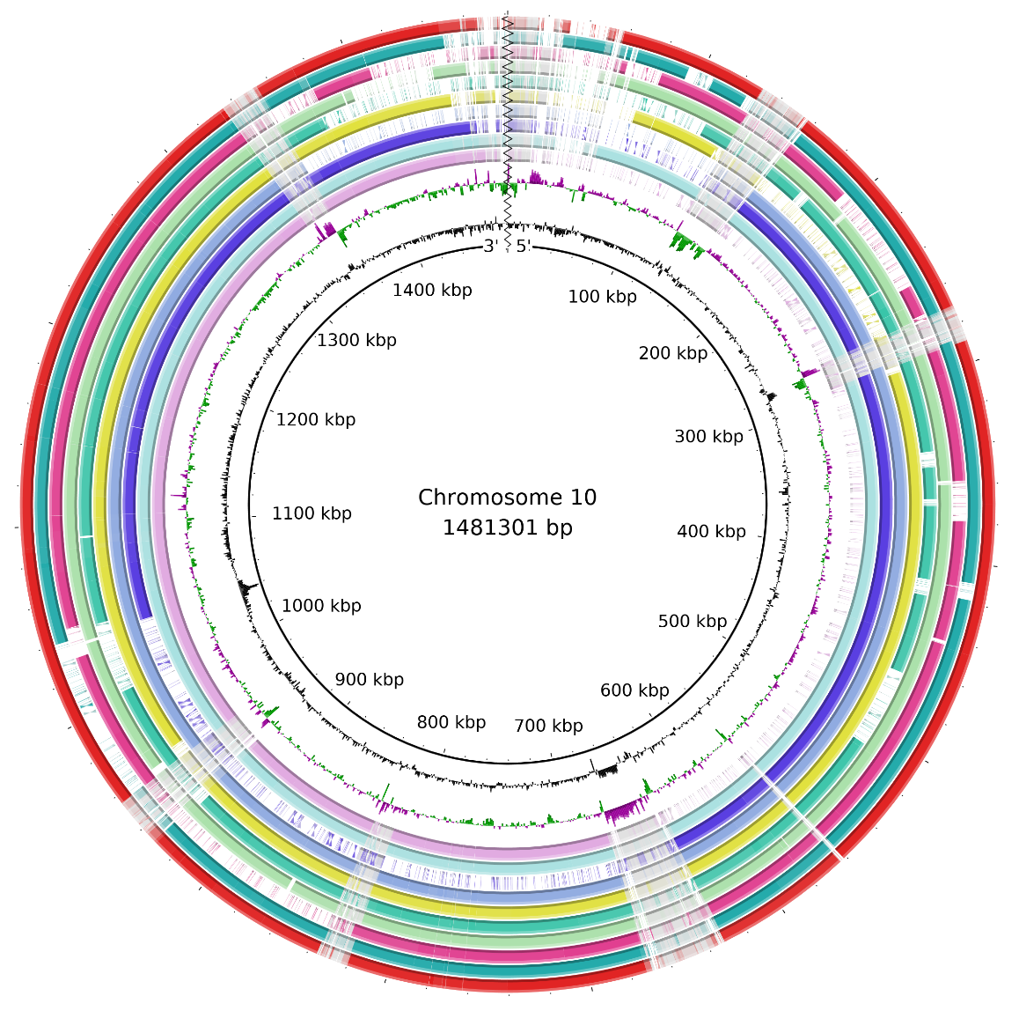
Bioinformatics training
Getting hands on with command line, bioinformatic tools and metagenomic data
Metagenomic Analysis

Slide 2

SESSION SET-UP
It’s OK. I’ll wait.
Explore what you can do (within reason)
Ask questions
Feel free to stop me to give more information or context
Hopefully, you have given this a perusal before today
Note: Code to enter will be in purple and comments will be in green
Purple is for you to enter in your terminal and run
Green explains what the purple command does

Slide 3

AIMs:
Beware ye who enter here
Install some tools
Carry out basic QC filtering and considerations
Align raw reads against a reference genome
Discover the microbial species present in the same
Calculate some basic stats on the generated data
Consider next steps

Slide 4
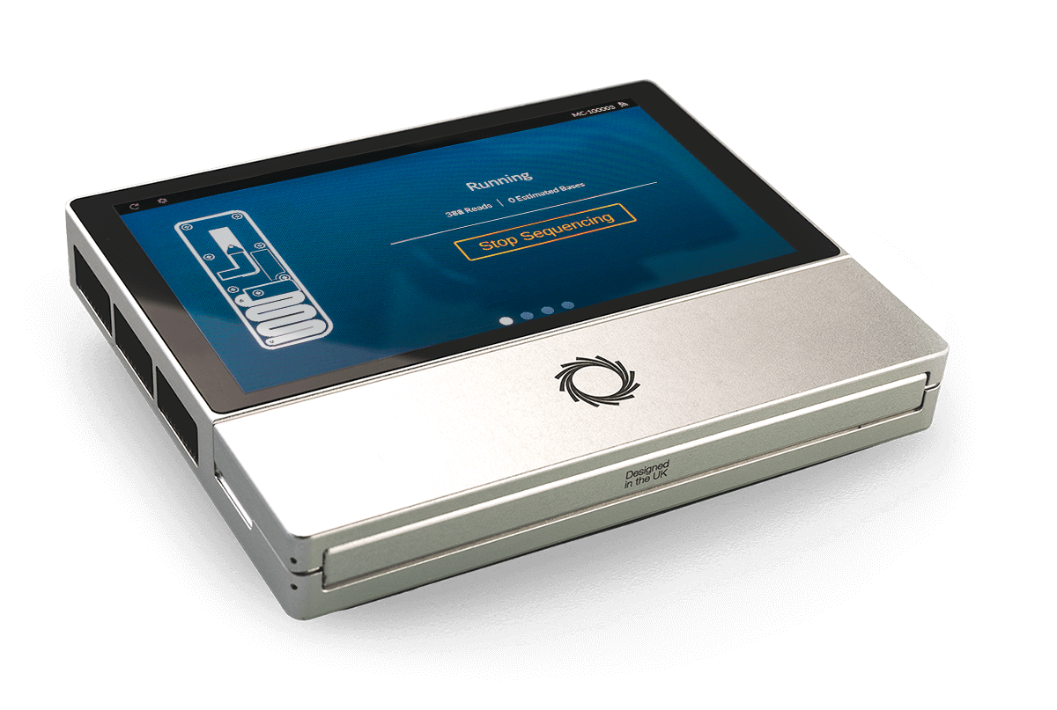
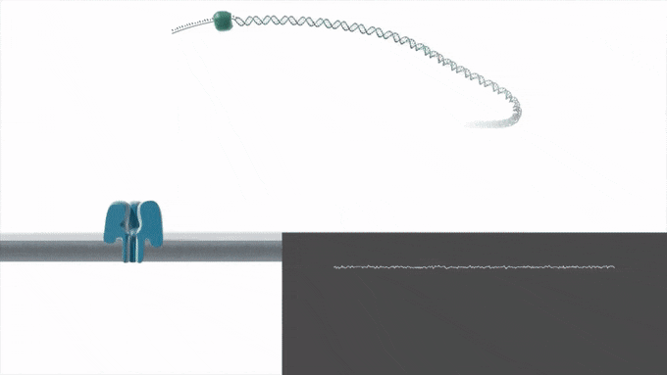
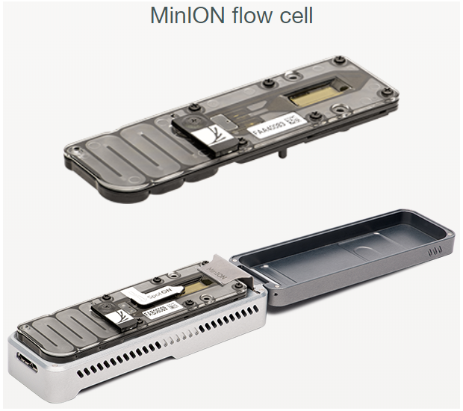
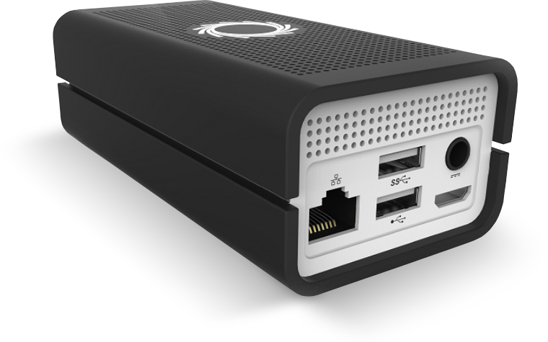
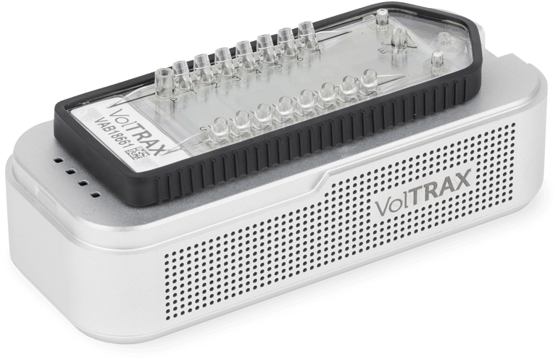
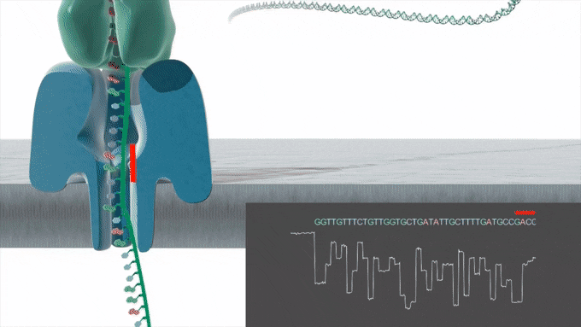
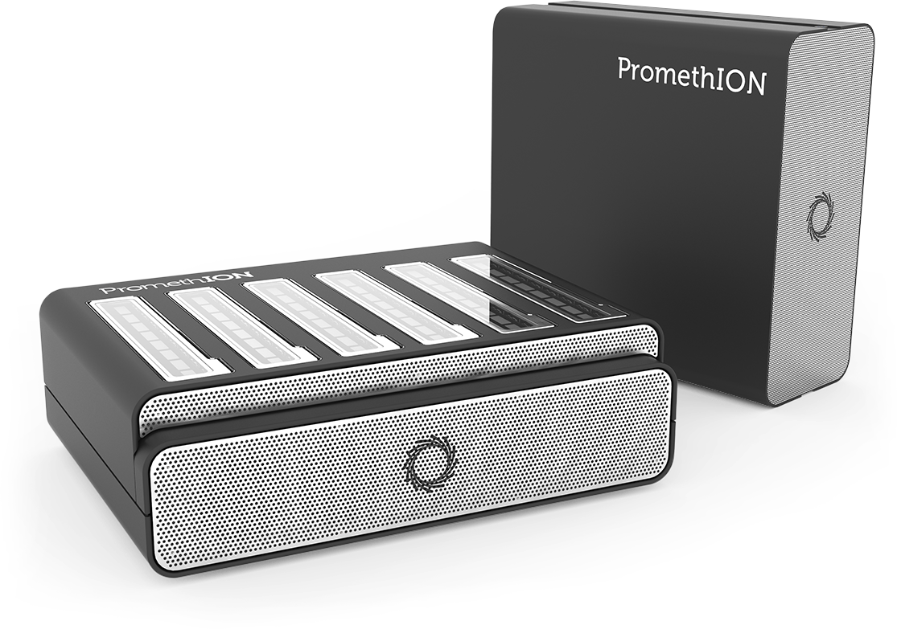
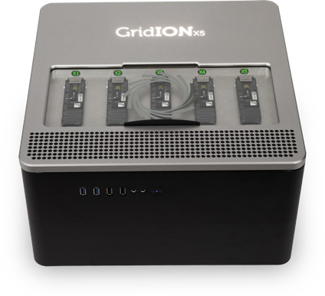
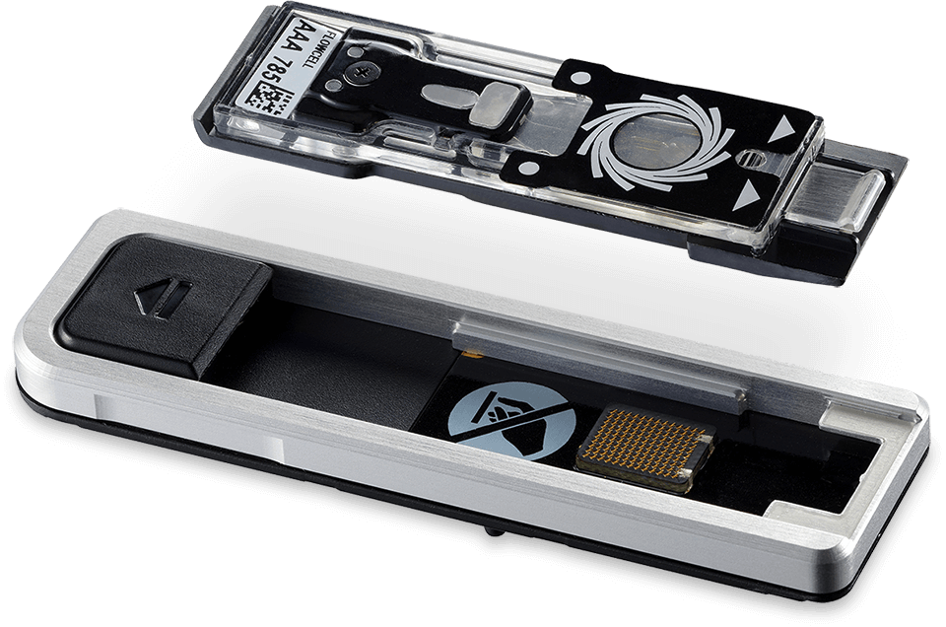
NANOPORE SEQUENCING
Pass it through a hole
A single molecule sequencing platform based on nanopores
Changes to the ionic current generates unique, readable events that are interpreted as 3-6 nucleotides
No need to digest or amplify input DNA
Single strand sequencing allows identification of base modifications
Relatively cheap at $12.50 - $40 per Gb data generated
Highly portable
Versatile
Very long reads – 500bp to >1.5Gb
MinION

Slide 5
HOW BASECALLING WORKS
If only we spoke 6 million universal languages
Basecalling is the process of interpreting the squiggle back into nucleotide bases (A,C,T,G)
This is done using different type of algorithms; like Convolutional Neural Networks (CNNs) and Recurrent Neural Networks (RNNs)
Both of these are really just algorithms that have been trained to determine what the signal of nucleotide bases look like and then use that to infer what your sequencing squiggles look like
There will always be room for improvement for these algorithms. The more data that is used to train them, the more accurate they get
You can also make it even more accurate by doing the training yourself on specific datasets!
So basecalling is almost always the first step Oxford Nanopore data analysis

Slide 6



conda
A true lifesaver
Installing software is one of the worst things to do in Bioinformatics
Conda makes this easy.
Conda essentially allows you to install software into standalone environments which do not affect the rest of the computer
AND it install all the dependencies of a tool making life so much easier.
HOWEVER, it is not perfect. Things can still go wrong. Some tools may not work well with others and cause one or many tools to break!
Conda should already be installed on the cluster but we can check
Another environment
Metagenomics environment

Slide 7

USING CONDA
You are caught in my field
Remember the rooms? Those would be called ‘environments’
To work with conda, you have to create the environment and install the software within that environment
conda create -n metagenomics_env
Enter the environment
conda activate metagenomics_envs
To find the tools go to: https://anaconda.org/
Then type in a tool to search for
Be aware that not all tools will be on here
And if they are on there, they may not be the most updated version
Generally the top hit is the most downloaded one and that should work
Scroll to the bottom and that will give you instructions on how to install it
E.g. conda install –c bioconda porechop
Here porechop is the tool you want to download
bioconda is the channel or the database you want to download porechop from

Slide 8

Install TOOLS
Get them on!
Tool | Availability
Guppy | Only on the Nanopore community
Porechop | On Conda
FastQC | On Conda
NanoPlot | On Conda
NanoFilt | On Conda
Minimap2 | On Conda
Samtools | On Conda
Assembly-Stats | On Conda
Bedtools | On Conda
Install conda tools with:
conda install -c bioconda porechop minimap2 samtools bedtools nanofilt nanoplot fastqc nanoplot assembly-stats
Notes:
Generally you dont want to install so many tools at the same time unless you know they dont mess with one another. Software are really quite sensitive and specifically coded

Slide 9

guppy
Give me the chaff and nothing else
Guppy is the basecaller designed by Oxford Nanopore
It carries out basecalling, demultiplexing, barcode removal and a lot more.
Comes with two algorithms. One is the ‘fast’ mode and the other is the ‘high-accuracy’ mode.
Fast is less accurate but requires less processing power and time
High-accuracy is more accurate but requires more computing power and specialist equipment like a GPU
If a sequencing run is multiplexed with multiple isolates, demultiplexing is carried out by comparing the basecalled reads to a library of known barcodes
Where similarities are found, the reads are placed in the same file
This is demultiplexing

Slide 10

PORECHOP
Chop’d n’ screwed
Once basecalling and demultiplexing is done, adapters still need to be removed
Porechop does this as well as other functionalities
Porechop also carries out basecalling however it is no longer accurate enough
Porechop has been unsupported since 2018 however, the adapter removal is still applicable

Slide 11
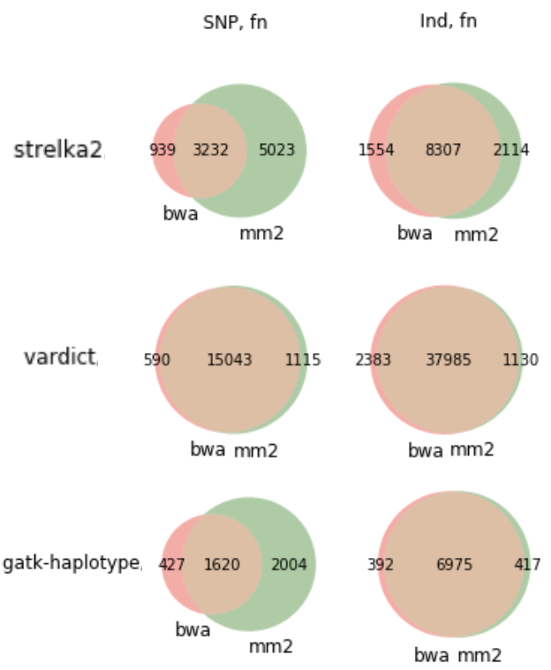
MINIMAP2
Me and you, cheek to cheek
This is an alignment tool that essentially matches your sequence against another sequence
There are many MANY other aligners out there however minimap2 is one of the most accurate and fastest
For metagenomic alignments. minimap2 would be most aligned
Other examples of aligners are nucmer, bwa, minimap etc
Minimap2 is incredibly complicated behind the scenes
It works by breaking your sequence and the reference into small bits called k-mers
The k being a given number i.e. a 27-mer, 72-mer, 56-mer etc
Then compares these k-mers and tries to make the longest chain out of them

Slide 12

QUALITY CONTROL
Offset!
There are a variety of tools to carry out different forms of quality assessment and control
NanoFilt: carries out filtering of reads by length and quality
FastQC: Gives you a way to assess the quality of your reads and produces visual graphs to aid in this
Assembly-stats: A simple statistical assessment tool. Calculates total length, reads and N50
N50: The length of the read in which reads longer than this encompass 50% of the total length of the file or genome

Slide 13

samtools
I’m just the middleman
A package of different tools and scripts to manipulate alignment sequence data
It is really only used on data after it is aligned against something
Samtools lets you see how well something aligns by looking at alignment statistics
Samtools also visualises the alignment, determines what maps and what does not map and even preliminary SNP calling
It is widely used and almost indispensable in any bioinformatics work

Slide 14

OTHER TOOLS YOU may need some day
You never know what the future might bring
Flye – de novo genome assembler with a metagenomics mode
Blobtools – Contamination evaluation of genome assemblies. Can tell you if you have sequences from different organisms
Racon – Long-read polishing
Medaka – Long-read correction and consensus
Quast – Quality assessment tool for genome assemblies
BUSCO: Allows a comparison of orthologous sequences to determine how complete a genome assembly is
Many More

Slide 15
ANALYSING OUR DATA

Slide 16
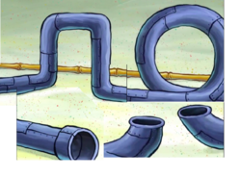
PIPELINE
Run through the pipes from the basilisk
Basecalling
Demultiplexing
Adapter removal/trimming
Align against Macaque genome
Remove unmapped reads
QC checks
Upload to OneCodex
Align reads against desired genome
Extract the mapped reads

Slide 17
BASECALLING
Tis only but the first step
Request access to the GPU partition
srsh --partition=gpu --gpus=1 --mem=8G --cpus-per-task=16G
Note: there is more you can do with this command. Read the documentation: https://help.cropdiversity.ac.uk/gpu.html?highlight=gpu
Create a screen:
screen -S training_screen
Basecalling Command:
~/path/to/bin/guppy_basecaller –i ~/projects/uosa/Janet_Cox_Singh/Metagenomics/April2021_Optimisation_Sequencing_2samples/RawFiles/Macaque_1_20_04_21/no_sample/20210420_1647_MN17366_FAP72684_88de1f3e/fast5/ --save_path ~/scratch/private/Metagenomics/Basecalled/ --flowcell FLO-MIN106 --kit SQK-LSK109 -r -v -q 0 --qscore_filtering -x auto --num_callers 8
This dataset will take about 3 hours to complete
Detach from the screen: Ctrl A+D
Reconnect to the screen with: screen -r training_screen
Let’s break down this command. Type in:
~/path/to/bin/guppy_basecaller –help
Once complete, carry out demultiplexing. If you are not demultiplexing, enter: exit

Slide 18

DEMULTIPLEXING
Throw it in the bag
If you are not on the GPU access, re-run the GPU request from the previous slide
Demultiplexing command:
~/path/to/bin/guppy_barcoder -i ~/scratch/private/Metagenomics/Basecalled /pass/ --save_path ~/scratch/private/Metagenomics/Demultiplexed/ -r -q 0 --barcode_kits EXP-NBD104 -t 16 -x auto --detect_mid_strand_barcodes | exit
Once again, lets break this command down. Enter ~/path/to/bin/guppy_barcoder –help
This could take up to 6 hours
Here we could also ask it to remove barcodes but that takes an extra 3 hours but another tool does this faster

Slide 19
REMOVE ADAPTERS WITH PORECHOP
And…. Its gone
We now need to request non-GPU access:
srsh --x11 --partition=short --cpus-per-task=12 --mem=12G
Then activate the conda environment
conda activate metagenomics_env
We need to remove adapters and we do this using porechop
porechop -i Demultiplexed/barcode01/fastq_runid_e2aff56e1a1f152057a44138824e3737494b0fd4_0.fastq.gz -o AdapterRemoved/barcode01.fastq.gz --verbosity 2 --threads 12 --format fastq.gz
This takes a while so do this, we will get this going first and come back to it.
Once this running, detach from the screen: Ctrl A+D

Slide 20
QUICK STATS CHECK
Just a quickie
Back in your HOME directory, we need to re-activate the conda environment
srsh --x11 --partition=short --cpus-per-task=8 --mem=8G
conda activate metagenomics_env
Lets look at some basic stats of the demultiplexed output with assembly-stats
assembly-stats Demultiplexed/barcode01/output.fastq
Output is a basic readout of the bp length, the number of reads, longest read and also N50 but at this point, N50 is not necessary for this step
You can save the output of this to a txt file for later use if you wish
Remember how we saved to files in the last session
Then we want to gzip the fastq files to reduce the amount of space they take and to make it somewhat faster to process them
Remember how we did this in the last session

Slide 21
QUALITY CHECK
Are you sure its good?
We want to see some quality information on the data so far. There are two ways we can do this with FastQC
FastQC is beneficial because you can do it from a user interface or directly from the command line
Window: in your terminal type: `fastqc`
Command line: type: `fastqc -t 8 -o Quality_Checks/FastQC/Demultiplexed/ Demultiplexed/barcode01/output.fastq`
From FastQC, we can see there are overrepresented sequences. We need to remove adapters. This is what porechop is doing
Let’s check to see if porechop is done: screen -r training_screen

Slide 22
Exercise - CHECK STATS AND QUALITY AGAIN
Again, again, again-again
Now that adapter removal is done, have a look at the results
What is the length of the longest read for barcode01
Which has more reads between barcode01 and barcode02
What does the quality look like in FastQC
Do you still see evidence of adapters or overrepresented sequences?

Slide 23
FILTER READS
Make it smaller
So here, we can choose to filter by length or quality or both
Filtering by quality with Nanopore data is somewhat difficult due to the generally low quality raw reads
However we can filter by length to remove reads shorter than 1000bp
Note: This is an arbitrary length which I chose. You can change this at another time
gunzip -c AdapterRemoval/barcode01.fastq.gz | NanoFilt -l 1000 | gzip > Filtered/barcode01_clean.fastq.gz

Slide 24

DOWNLOADING the reference genome
Take the red pill
Download the reference genome for the host which we want to remove from the background
On your browser, go to https://www.ncbi.nlm.nih.gov/
Next to the search box, switch the dropdown bar to `Genome`
Search for the desired genome. Here we want: `Macaca fuscata`
On the Genome page, you will see a banner at the top, right the option to 'Download sequences in FASTA format for genome'. Copy the link address.
Then in gruffalo on the terminal: download it with:
wget https://ftp.ncbi.nlm.nih.gov/genomes/all/GCA/003/118/495/GCA_003118495.1_macFus_1.0/GCA_003118495.1_macFus_1.0_genomic.fna.gz
Notes:
For this particular example, we know there is only one whole genome for M.fuscata. However, using this Genome option takes you to the page of the 'gold-standard' genome which may not necessarily be what you want. To see all options of assemblies for an organism, Choose the `Assembly` from the drop down bar. Another advantage of this is that you can get extra information like the starting coverage of the assembly as well as what technology was used to sequence it
Lets explore what we get from choose both Genome and Assembly
NCBI is a huge site that has multiple ways of navigating to the same information so at some point, you may want to get comfortable with it to an extent.

Slide 25
Alignment
They’re such a lovely couple
Now we need to take out the host DNA sequences
Index the reference we just downloaded:
minimap2 -x map-ont –d GCA_003118495.1_macFus_1.0_genomic.fna.mmi GCA_003118495.1_macFus_1.0_genomic.fna.gz
Align the reads against the index you just made
minimap2 -ax map-ont GCA_003118495.1_macFus_1.0_genomic.fna.mmi Filtered/barcode01_clean.fastq.gz -t 12 | samtools view -@ 12 -b - | samtools sort -@ 12 -o Alignment/barcode01_vsMacaq.bam -
Lets see what this command does:
minimap2 --help

Slide 26
alignment
What’s in the box
Check how much aligns:
samtools flagstat Alignment/barcode01_vsMacaq.bam
Remove what does not map into a new fastq file
samtools view --threads 12 -f 4 -b Alignment/barcode01_vsMacaq.bam > Alignment/barcode01_clean.fastq
Convert bam to fastq
bedtools bamtofastq -i Alignment_porechopd/barcode01_clean.bam -fq Alignment_porechopd/barcode01_clean.fastq
So now we have a FASTQ file that only contains non-host sequences
Zip the FASTQ file and download it with FileZilla

Slide 27
ONECODEX
Upload it to the cloud
OncCodex is an online site which allows some classification of sequences by comparing any sequences against a large database
Go to: https://www.onecodex.com/
Make an account
Upload the downloaded FASTQ.gz file
It will automatically analyse
Be aware that you get 25 free samples to upload and analyse

Slide 28
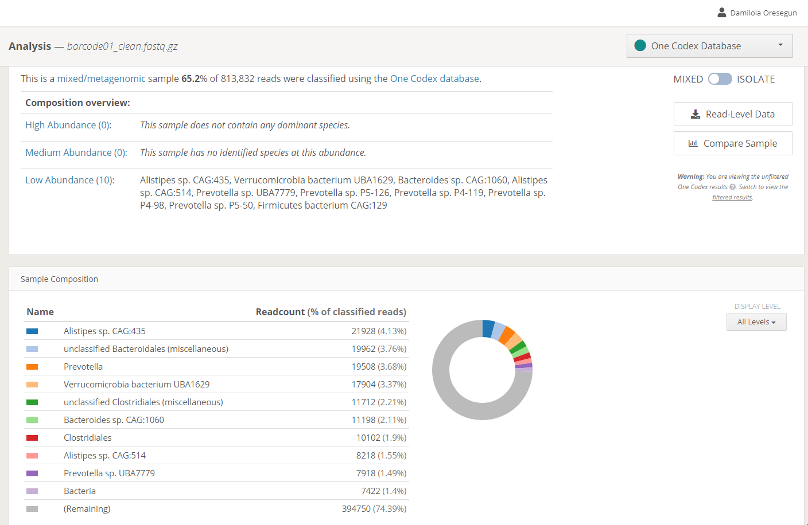
ONECODEX

Slide 29
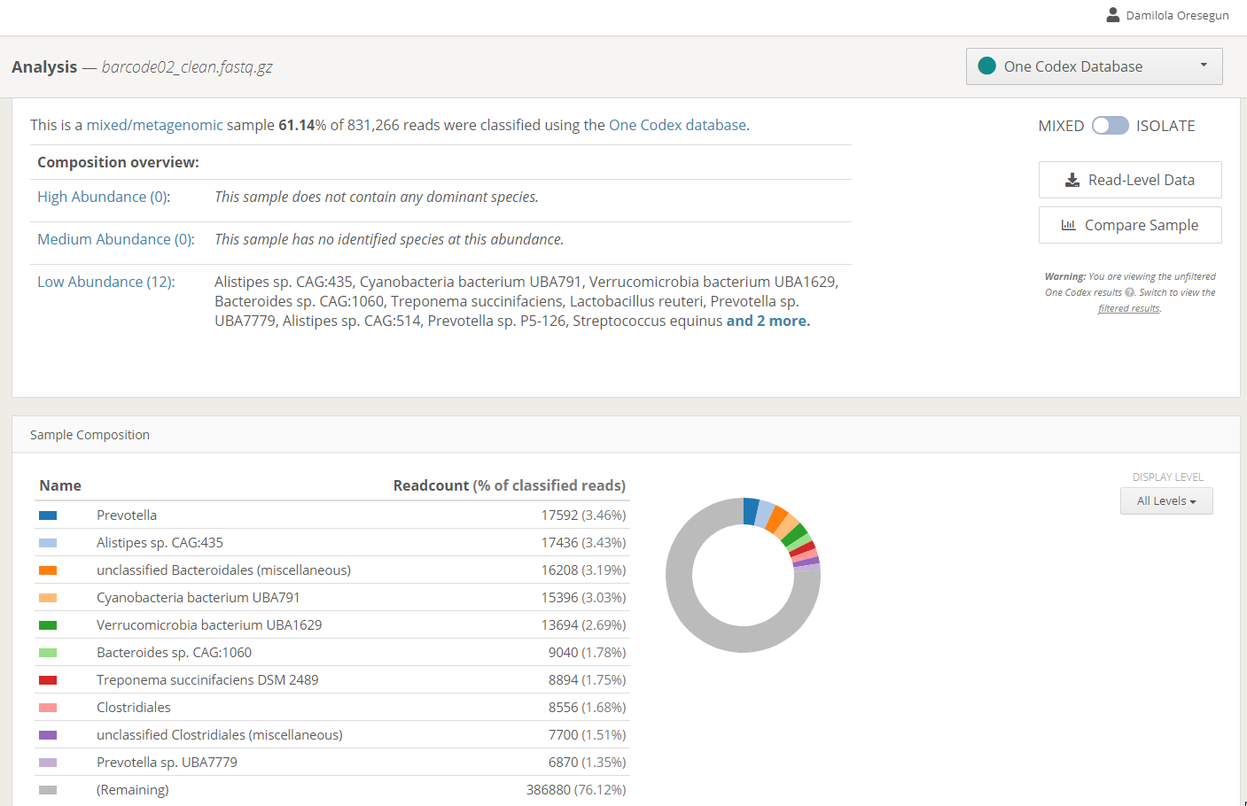
ONECODEX

Slide 30
NEXT STEPS
Find out next time
Explore OneCodex to see what it contains
What species are best most represented?
Do you see signs of viruses?
What type of question does this open up for you?
Can you figure out how to download this data for later analysis?

Slide 31
EXERCISES
I believe in you
Find a species you find interesting from the OneCodex output
Check NCBI to see if it has a reference genome. If it does, download it on Gruffalo
Then on Gruffalo, align the fastq against the reference genome of your species of interest
Check the alignment stats
Extract the reads which align to this reference genome and convert it to FASTQ
Visualise the new FASTQ of desired reads on FastQC and check the assembly-stats output for it

Slide 32
FINAL THOUGHTS
It’s the final countdown
This is only a taster of metagenomic sequencing analysis
There are multiple other pipelines available, multiple other tools for every step we have taken here
After OneCodex, you have an idea of what is in your sequence so that opens up more questions for you to answer
After this, you may wish to carry out some de novo genome assembly or just reference based assembly to see what assembles
That is out of the scope of this session and further work would likely be done by a dedicated bioinformatician or analyst

